Slide 1

Bees Local Phase Quantization Feature Selection for RGB-D Facial Expressions Recognition
Seyed Muhammad Hossein Mousavi
Atiye Ilanloo
Independent Researcher, Tehran, Iran
Faculty of Humanities- Psychology, Islamic Azad University-Rasht, Gilan, Iran
mosavi.a.i.buali@gmail.com
elanlooatiye@gmail.com

Slide 2
Introduction
Facial Expressions Recognition
After face detection and face recognition.
Facial Expressions Recognition (FER) and Facial Micro Expressions Recognition (FMER).
Harder than face detection and recognition as they could have micro-movements.
Differs from one person to another.
Each expression could be misunderstood in different races as skin wrinkles effects recognition direction.
Facial expressions are made and calculated by Facial Action Coding Systems (FACS).
Bees Local Phase Quantization Feature Selection for RGB-D Facial Expressions Recognition 1

Slide 3
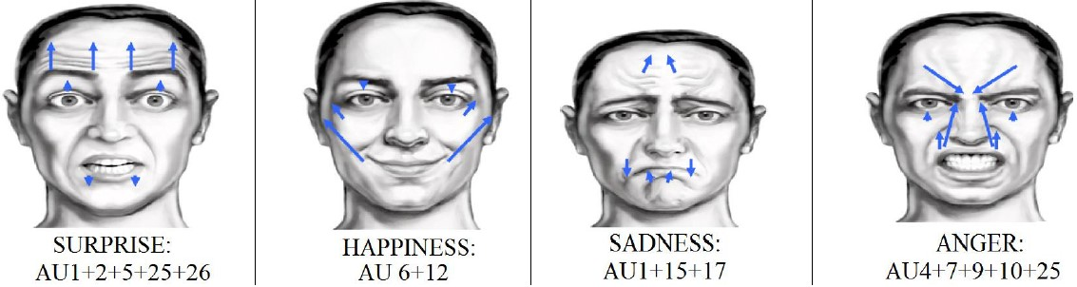
Introduction
Facial Expressions Recognition
Categorized in seven primary facial expressions of Joy, Anger, Disgust, Sadness, Fear, Surprise and Neutral.
For example, and for Joy expression, Action Units (AU) of 6 + and 12 are involved.
FMER is FER with more precise calculations as little changes appear on the face.
Bees Local Phase Quantization Feature Selection for RGB-D Facial Expressions Recognition 2

Slide 4
Introduction
Bio-inspired algorithms
Bio-inspired algorithms are mathematical models of animals social behavior in a manner that leads problems to an optimal solution.
These algorithms could be employed in multiple optimization tasks, such as regression, clustering, feature selection, Minimum Spanning Tree (MST), Hub Location Allocation (HLA) and a lot more.
One of these bio-inspired algorithms which has very high efficiency is called Bees Algorithm (BA) .
Bees Local Phase Quantization Feature Selection for RGB-D Facial Expressions Recognition 3

Slide 5
Introduction
Bees
Bees Algorithm, simply implements the social behavior of honey bees to search (in neighborhood manner) for food in flowers.
Agents, Scouts and Forager bees are involved in global and local search to reach the best solution.
Waggle dance in done by scouts which found the best sites.
Those who landed on elite sites, recruit new members.
List of best bees based on local and global goes to next generation and cycle stopes by termination criterions conditions.
Bees Local Phase Quantization Feature Selection for RGB-D Facial Expressions Recognition 4

Slide 6
Introduction
Kinect Sensor and Depth Data
Kinect V.2 is cheap and for educational purposes.
Color data with 1920*1080 resolutions and Depth data in 512*424 resolutions with 30 (FPS).
Color data is based on Red, Green and Blue (RGB) channels.
Depth data is a grey like image which sometimes called 2.5-Dimensional (2.5-D) image.
Bees Local Phase Quantization Feature Selection for RGB-D Facial Expressions Recognition 5

Slide 7
Introduction
Kinect Sensor and Depth Data
Each pixel of Depth image in Kinect sensor, represents the distance between Sensor and Subject in millimeters.
For instance 2000 value in pixels means object is in distance of 2 meters from the sensor.
Depth images aids color images to increase recognition accuracy.
As depth images are generated from infrared particles, the Kinect sensor could operate in absolute darkness.
Bees Local Phase Quantization Feature Selection for RGB-D Facial Expressions Recognition 6

Slide 8
Introduction
Feature Selection
Is useful In dealing with big data or massive number of samples (specially image samples).
After the feature extraction step, selecting the most impactful features out of data.
Feature selection or dimensionality reduction helps to decrease computational time and getting rid of outliers in the dataset.
Outliers lead classification task into misclassification and removing them is vital.
Bees Local Phase Quantization Feature Selection for RGB-D Facial Expressions Recognition 7

Slide 9
Introduction
Feature Selection
In this paper, Bees Algorithm is employed as a feature selection tool.
Here, the Local Phase Quantization (LPQ) feature is extracted.
LPQ provides 256 features and Bees feature selection, select less than 128 features without classification accuracy drop.
Bees Local Phase Quantization Feature Selection for RGB-D Facial Expressions Recognition 8

Slide 10
Prior Related Researches
These algorithms could be applied directly on extracted image or signal features.
Or could be applied on unfolded version of images, signals or any type of numerical matrix.
Bees Local Phase Quantization Feature Selection for RGB-D Facial Expressions Recognition 9

Slide 11
Prior Related Researches
Principal Component Analysis (PCA) (invented by Karl Pearson in 1901) generates new matrixes, named Principal Components (PA).
Each PA is a linear mixed of the original matrixes.
By selecting best principles components, best features will be chosen.
The Lasso (Robert Tibshirani in 1996) is a regularization method for estimating generalized linear models.
Lasso is a shrinkage approximator: it makes coefficient approximated that are biased to be tiny.
By shrinking features, best features remain.
Bees Local Phase Quantization Feature Selection for RGB-D Facial Expressions Recognition 10

Slide 12
Prior Related Researches
The chi-square test (Jin, Xin, 2006) is a statistical method employed to contrast observed data and expected ones.
The objective is to specify if there is any changes between observed data and expected data.
If the target variable is independent of the feature variable, it is possible to ignore that specific feature.
If they are dependent, the feature is very significant.
PSO feature selection
Firefly feature selection
Bees feature selection.
Bees Local Phase Quantization Feature Selection for RGB-D Facial Expressions Recognition 11

Slide 13
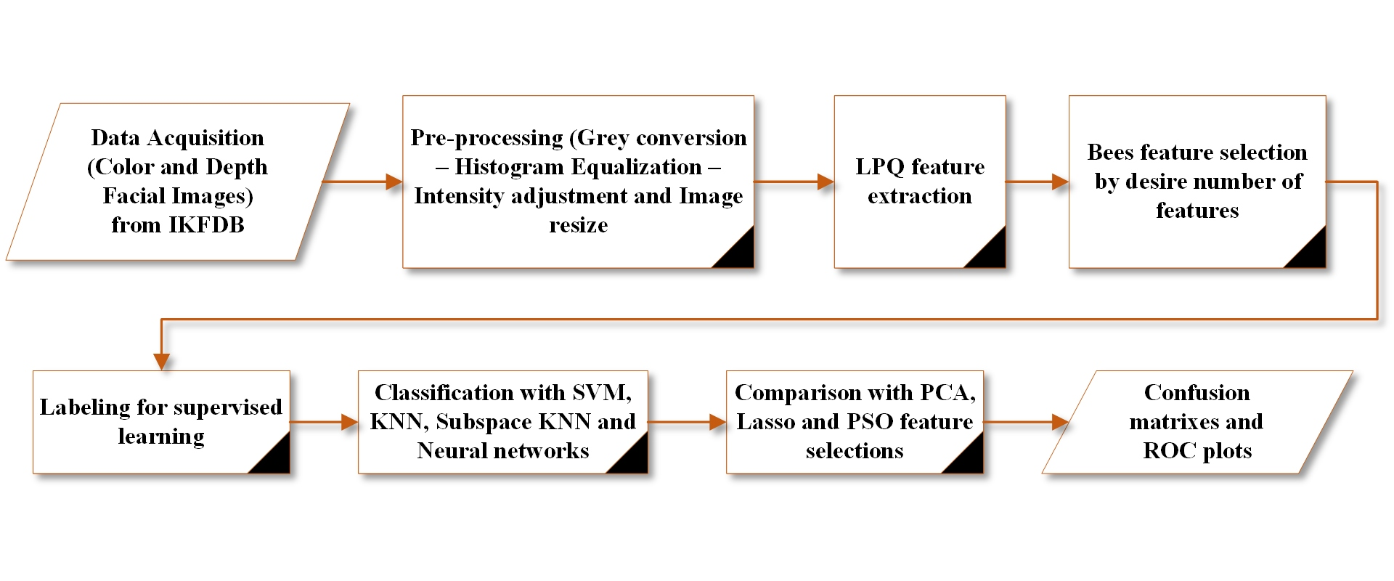
Proposed Method
Bees Local Phase Quantization Feature Selection for RGB-D Facial Expressions Recognition 12

Slide 14
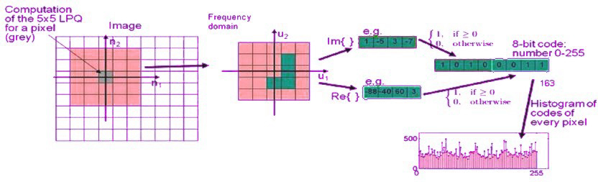
Proposed Method
Local Phase Quantization
LPQ is a frequency neighborhood-based feature based on Fourier transform.
It manipulated blurring effect in magnitude and phase channels.
Phase channel is capable of deactivating low pass filters that exists in some images.
LPQ features is perfect to be use on depth data in frequency domain.
Bees Local Phase Quantization Feature Selection for RGB-D Facial Expressions Recognition 13

Slide 15
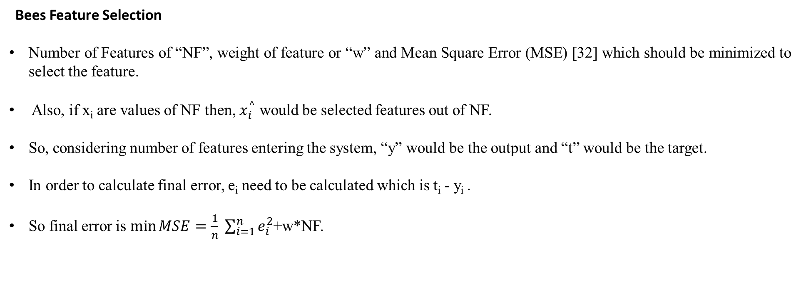
Proposed Method
Bees Feature Selection
Number of Features of “NF”, weight of feature or “w” and Mean Square Error (MSE) [32] which should be minimized to select the feature.
Also, if x_{i} are values of NF then, $x_{i}^{^}$ would be selected features out of NF.
So, considering number of features entering the system, “y” would be the output and “t” would be the target.
In order to calculate final error, e_{i} need to be calculated which is t_{i} - y_{i} .
So final error is $\min{MSE=\frac{1}{n} \sum_{i=1}^{n}{e_{i}^{2}}}$+w*NF.
Bees Local Phase Quantization Feature Selection for RGB-D Facial Expressions Recognition 14

Slide 16
Proposed Method
Bees Feature Selection
This goes for all features and finally those features with lowest MSE will be selected.
In combination of Bees and feature selection, each feature vector is considered as a bee with different fitness function.
Those bees which could fit into final iteration would be selected alongside with their related features with lowers error as it mentioned.
Bees Local Phase Quantization Feature Selection for RGB-D Facial Expressions Recognition 15

Slide 17
Proposed Method
Bees Feature Selection
Start
Load LPQ features
Generating initial population (Features of F)
Define NF (number of features) and w (wight of features)
Evaluating the population based on fitness function
Sorting
While max iteration is not satisfied
Select elite patches and non-elite best patches for local search
Recruit forager bees for elite patches and non-elite best patches
Evaluate the fitness value of each patch
Sorting (select NF of F)
Allocate the rest of the bees for global search
Evaluate the fitness value of non-best patches
Sorting (Select NF of F)
End While
Select best first NF’s
End
Bees Local Phase Quantization Feature Selection for RGB-D Facial Expressions Recognition 16

Slide 18
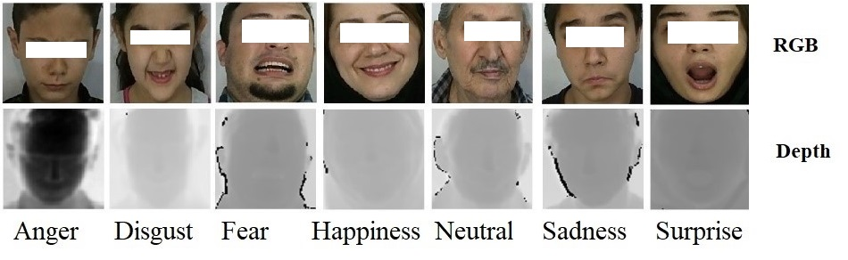
Validation and Results
IKFDB data is used which is consisted of color and depth frames of seven main facial expressions for this experiment.
Here 1000 color and depth samples of five expressions (each 200 samples) are used.
Comparison would be between proposed Bees LPQ, PSO LPQ, PCA LPQ, Lasso LPQ and solo LPQ.
SVM, KNN, Shallow Neural Network and Ensembles Subspace KNN classification algorithms.
Bees Local Phase Quantization Feature Selection for RGB-D Facial Expressions Recognition 17

Slide 19
Validation and Results
Bees Local Phase Quantization Feature Selection for RGB-D Facial Expressions Recognition 18

Slide 20
Validation and Results
Bees Local Phase Quantization Feature Selection for RGB-D Facial Expressions Recognition 19

Slide 21
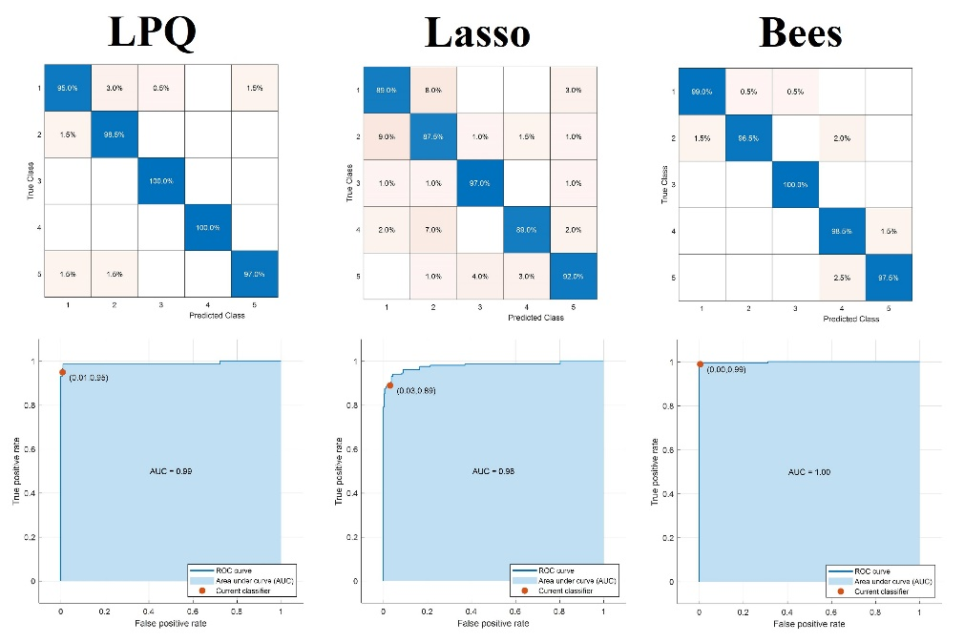
Validation and Results
SVM
LPQ = 256 feature
Lasso= 64 Features
Bees = 64 Features
Bees Local Phase Quantization Feature Selection for RGB-D Facial Expressions Recognition 20

Slide 22
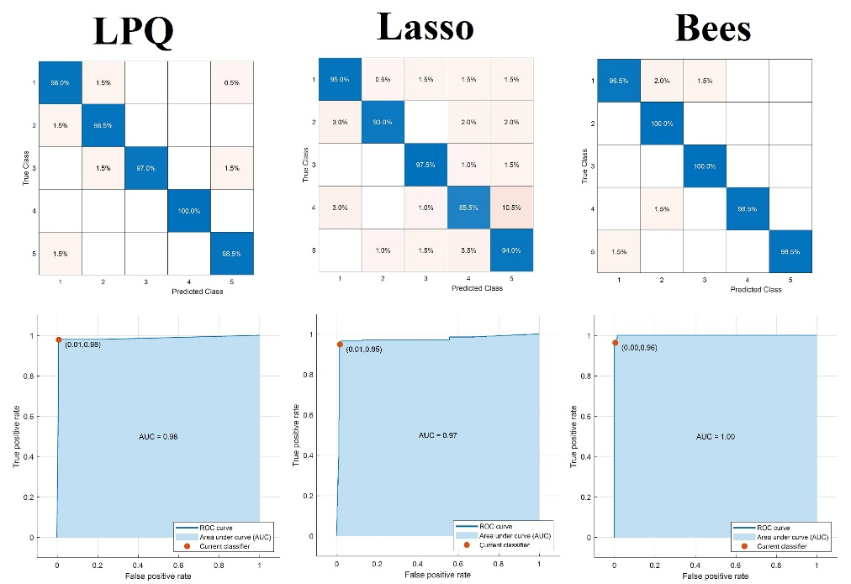
Validation and Results
KNN
LPQ = 256 feature
Lasso= 64 Features
Bees = 64 Features
Bees Local Phase Quantization Feature Selection for RGB-D Facial Expressions Recognition 21

Slide 23
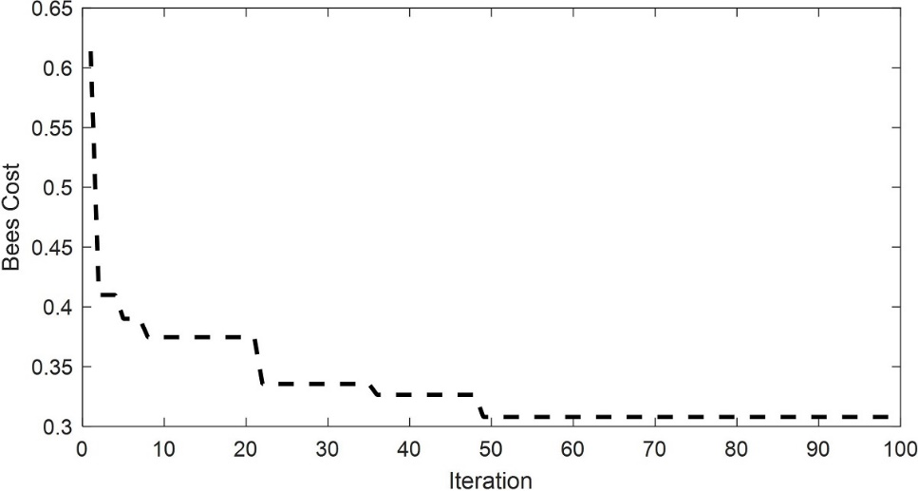
Validation and Results
Bees Local Phase Quantization Feature Selection for RGB-D Facial Expressions Recognition 22

Slide 24
Conclusion and suggestions
Employing bio-inspired algorithms for feature selection task could perform better than traditional feature selection algorithms in face analysis and especially facial expressions recognition task.
Defining feature selection cost function for Bees algorithm returned successful results for all four classification algorithms.
It can be concluded, Bees algorithm has great impact in feature selection optimization
However, run time increases
Bees algorithm with using just a quarter of features, could reach to a point which traditional algorithms are not capable of.
Using proposed method on more facial expressions and in other face analysis tasks such as face recognition is of future works.
It is suggested to use proposed method with more classification algorithms like tree, bayes.
It is suggested to comparing with more traditional and bio-inspired feature selection techniques such as fisher, GA and more.
Bees Local Phase Quantization Feature Selection for RGB-D Facial Expressions Recognition 23

Slide 25
References
Mousavi, Seyed Muhammad Hossein. "A new way to age estimation for rgb-d images, based on a new face detection and extraction method for depth images." International Journal of Image, Graphics and Signal Processing 10 (2018): 10.
Mousavi, Seyed Muhammad Hossein, and S. Younes Mirinezhad. "Iranian kinect face database (IKFDB): a color-depth based face database collected by kinect v. 2 sensor." SN Applied Sciences 3.1 (2021): 1-17.
Ekman, Paul, and Wallace V. Friesen. "Facial action coding system." Environmental Psychology & Nonverbal Behavior (1978).
Singh, Abhilash, Sandeep Sharma, and Jitendra Singh. "Nature-inspired algorithms for wireless sensor networks: A comprehensive survey." Computer Science Review 39 (2021): 100342.
Mousavi, Seyed Muhammad Hossein, Vincent Charles, and Tatiana Gherman. "An evolutionary Pentagon Support Vector finder method." Expert Systems with Applications 150 (2020): 113284.
Singh, Abhilash, et al. "A Gaussian process regression approach to predict the k-barrier coverage probability for intrusion detection in wireless sensor networks." Expert Systems with Applications 172 (2021): 114603.
Mousavi, Seyed Muhammad Hossain. "A New Clustering Method Using Evolutionary Algorithms for Determining Initial States, and Diverse Pairwise Distances for Clustering." International Journal of Mechatronics, Electrical and Computer Technology (IJMEC) 9.31 (2019): 4098-4110.
Ji, Bai, et al. "Bio-inspired feature selection: An improved binary particle swarm optimization approach." IEEE Access 8 (2020): 85989-86002.
Pham, D. T., et al. "Data clustering using the bees algorithm." (2007).
Pham, Duc Truong, et al. "The bees algorithm—a novel tool for complex optimisation problems." Intelligent production machines and systems. Elsevier Science Ltd, 2006. 454-459.
Pham, D. T., et al. "The bees algorithm." Technical Note, Manufacturing Engineering Centre, Cardiff University, UK (2005): 44-48.
Gonzalez-Jorge, H., et al. "Metrological comparison between Kinect I and Kinect II sensors." Measurement 70 (2015): 21-26.
Bees Local Phase Quantization Feature Selection for RGB-D Facial Expressions Recognition 24

Slide 26
References
Charles, Vincent, and Tatiana Gherman. "Achieving competitive advantage through big data. Strategic implications." Middle-East Journal of Scientific Research 16.8 (2013): 1069-1074.
Mousavi, Seyed Muhammad Hossein, VB Surya Prasath, and Seyed Muhammad Hassan Mousavi. "Persian classical music instrument recognition (PCMIR) using a novel Persian music database." 2019 9th International Conference on Computer and Knowledge Engineering (ICCKE). IEEE, 2019.
Mousavi, Seyed Muhammad Hossein, S. Younes MiriNezhad, and Atiye Mirmoini. "A new support vector finder method, based on triangular calculations and K-means clustering." 2017 9th International Conference on Information and Knowledge Technology (IKT). IEEE, 2017.
Dezfoulian, Mir Hossein, et al. "Optimization of the Ho-Kashyap classification algorithm using appropriate learning samples." 2016 Eighth International Conference on Information and Knowledge Technology (IKT). IEEE, 2016.
Yuan, Baohua, Honggen Cao, and Jiuliang Chu. "Combining local binary pattern and local phase quantization for face recognition." 2012 International Symposium on Biometrics and Security Technologies. IEEE, 2012.
Ismail, Asrul Harun, et al. "Combinatorial Bees Algorithm for Vehicle Routing Problem." Macromolecular Symposia. Vol. 396. No. 1. 2021.
Abdi, Hervé, and Lynne J. Williams. "Principal component analysis." Wiley interdisciplinary reviews: computational statistics 2.4 (2010): 433-459.
Tibshirani, Robert. "Regression shrinkage and selection via the lasso." Journal of the Royal Statistical Society: Series B (Methodological) 58.1 (1996): 267-288.
Kibria, B. M., and Shipra Banik. "Some ridge regression estimators and their performances." (2020).
Jin, Xin, et al. "Machine learning techniques and chi-square feature selection for cancer classification using SAGE gene expression profiles." International workshop on data mining for biomedical applications. Springer, Berlin, Heidelberg, 2006.
Shiraz, Rashed Khanjani, Vincent Charles, and Leila Jalalzadeh. "Fuzzy rough DEA model: A possibility and expected value approaches." Expert Systems with Applications 41.2 (2014): 434-444.
Bees Local Phase Quantization Feature Selection for RGB-D Facial Expressions Recognition 25

Slide 27
References
Zhang, Yishi, et al. "Feature selection using data envelopment analysis." Knowledge-Based Systems 64 (2014): 70-80.
Mistry, Kamlesh, et al. "A micro-GA embedded PSO feature selection approach to intelligent facial emotion recognition." IEEE transactions on cybernetics 47.6 (2016): 1496-1509.
Emary, Eid, et al. "Firefly optimization algorithm for feature selection." Proceedings of the 7th balkan conference on informatics conference. 2015.
Alomari, Osama, and Zulaiha Ali Othman. "Bees algorithm for feature selection in network anomaly detection." Journal of applied sciences research 8.3 (2012): 1748-1756.
Ding, Hongwei, et al. "Imbalanced data classification: A KNN and generative adversarial networks-based hybrid approach for intrusion detection." Future Generation Computer Systems 131 (2022): 240-254.
Ramasamy, Karthikeyan, Kiruthika Balakrishnan, and Durgadevi Velusamy. "Detection of cardiac arrhythmias from ECG signals using FBSE and Jaya optimized ensemble random subspace K-nearest neighbor algorithm." Biomedical Signal Processing and Control 76 (2022): 103654.
Mahdizadeh, M., and Ehsan Zamanzade. "On estimating the area under the ROC curve in ranked set sampling." Statistical Methods in Medical Research (2022): 09622802221097211.
Gupta, Varun, et al. "Detection of R-peaks using fractional Fourier transform and principal component analysis." Journal of Ambient Intelligence and Humanized Computing 13.2 (2022): 961-972.
Fraś, Mieszko, Marcin Witkowski, and Konrad Kowalczyk. "Convolutional Weighted Minimum Mean Square Error Filter for Joint Source Separation and Dereverberation." ICASSP 2022-2022 IEEE International Conference on Acoustics, Speech and Signal Processing (ICASSP). IEEE, 2022.
Bees Local Phase Quantization Feature Selection for RGB-D Facial Expressions Recognition 26

Slide 28
Thank you for your Attention
?

